Slide 1
Workflow of the Interface
Opening Screen - Log In
Explanation
Main Screen
Instructions of Sensor Wearing
Help Screen
Relaxation Techniques
Notification History
*This chart refers only to the screens that we’ve created.

Slide 2
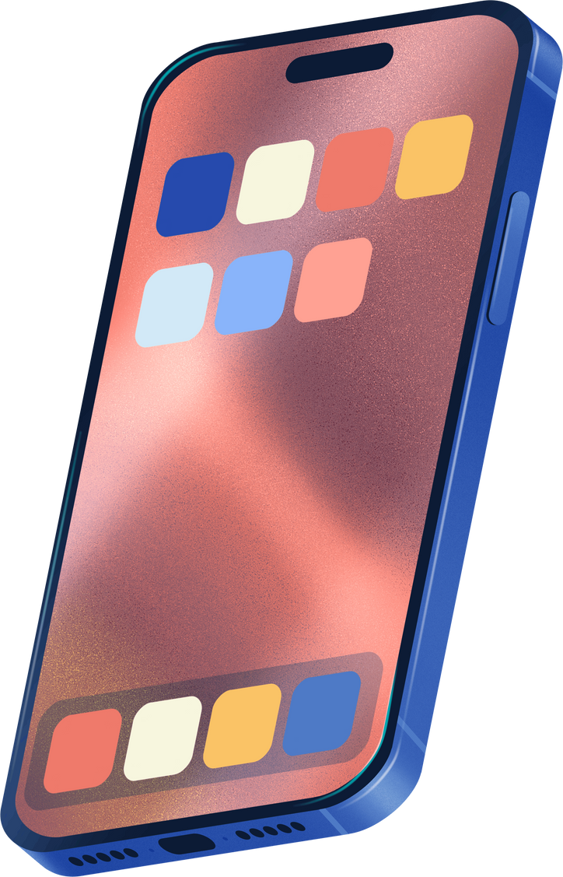
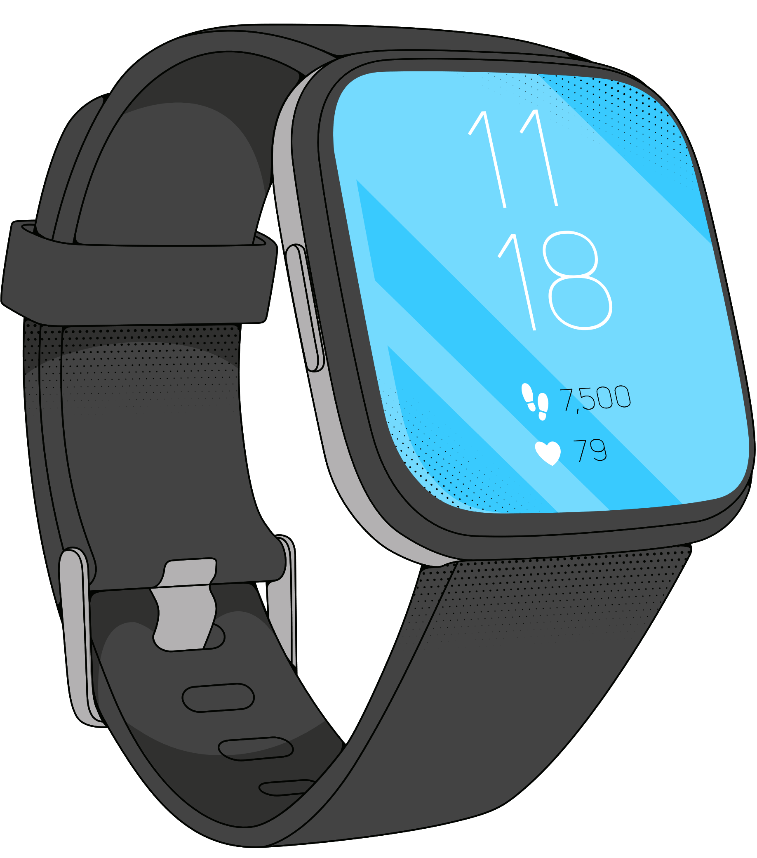
TeStress

Slide 3


TeStress
Dear Caregiver, Hello!
Please Sign In:
Username
Password
Patient ID
Log In
Forgot Password
Not registered? Click here to sign up.

Slide 4




How to Use the Application
First, make sure the patient wears the sensor correctly.
Instructions on how to wear the sensor
Click 'Start Measurement' and wait a few moments for the measurements to stabilize.
Start Measurement
Please wait, it can take a few moments

Slide 5




How to Wear the Sensor?
1
2
3
Place the sensor on the person’s wrist.
Adjust the straps on either side of the sensor. Make sure it is securely placed.
Press the button on the side of the sensor to activate it.
Back

Slide 6




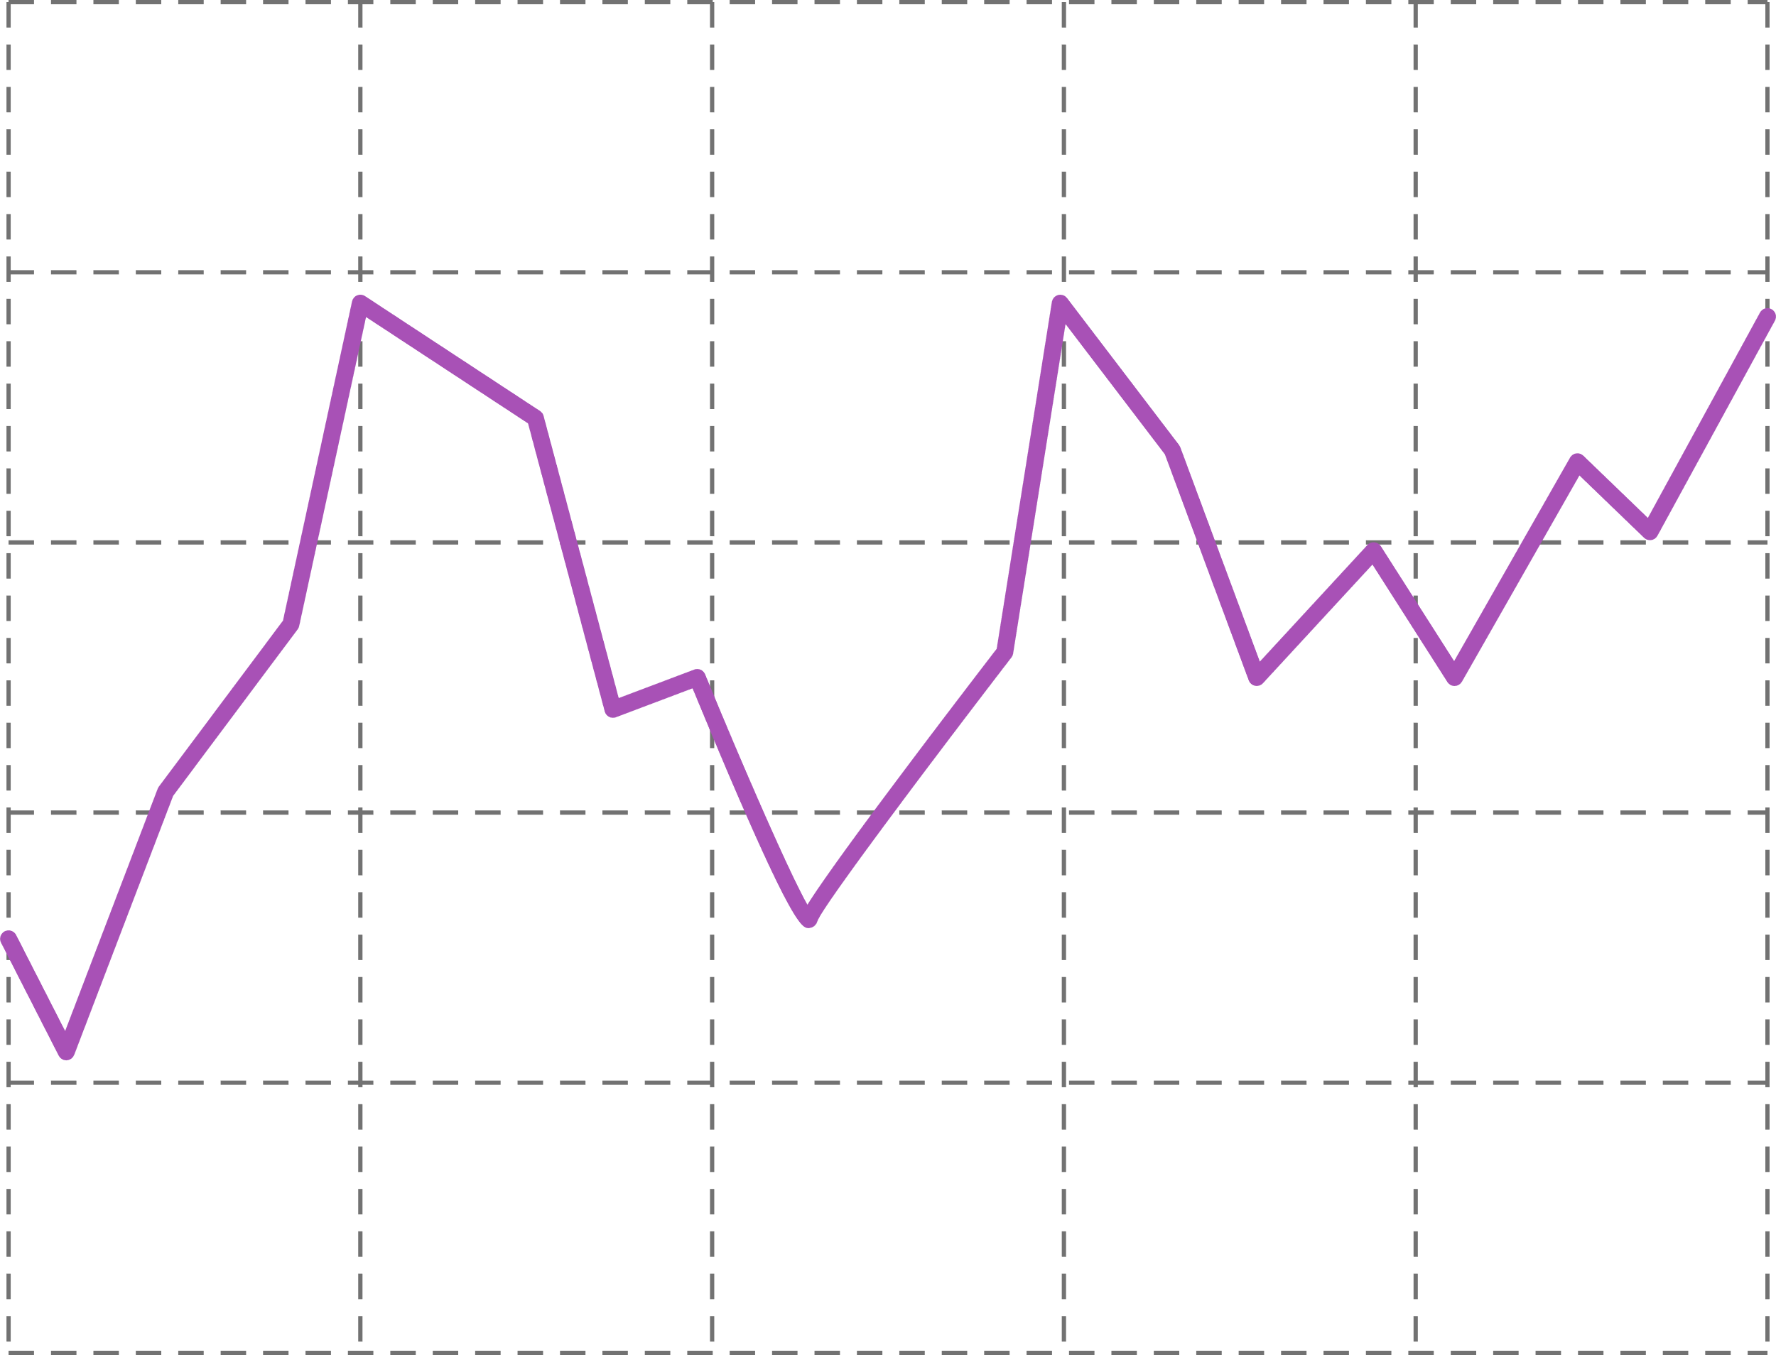





TeStress
HRV
Stress
8.0
6.0
0.0
3.0
4.0
2.6
2.0
HIGH
11:52:15
11:52:20
11:52:25
11:52:30
Profile
Help
Techniques
Summary
Notes:
למטה לקרוא לזה summery או analytics?
האייקונים לא קונסיסטנטיים קשה למצוא משהו טוב

Slide 7


TeStress
HRV
Stress
8.0
6.0
0.0
3.0
4.0
0.5
2.0
LOW
11:52:15
11:52:20
11:52:25
11:52:30
Profile
Help
Techniques
Summary
Notes:
למטה לקרוא לזה summery או analytics?
האייקונים לא קונסיסטנטיים קשה למצוא משהו טוב

Slide 8




Choose The Relaxation Technique
Breathing Exercises
Relaxing Videos
Music
GO
GO
GO
Back

Slide 9



Have a question about the app?
Have an emergency?
press to call emercency services
We Are Here To Help
Type your question here...
send
Back
Notes:
האם אנחנו צריכים את הדף הזה?

Slide 10

Notification History
Dismiss All
Stress Alert
X
10/03/2024 4:30 PM
See details
Stress Alert
X
09/03/2024 2:11 PM
See details
Your weekly stress summary is ready!
X
08/03/2024 11:32 AM
See details
Back

